Slide 1
Data Stuctures and Algorithms
Dr. Fidaa Abed

Slide 2
Graphs

Slide 3
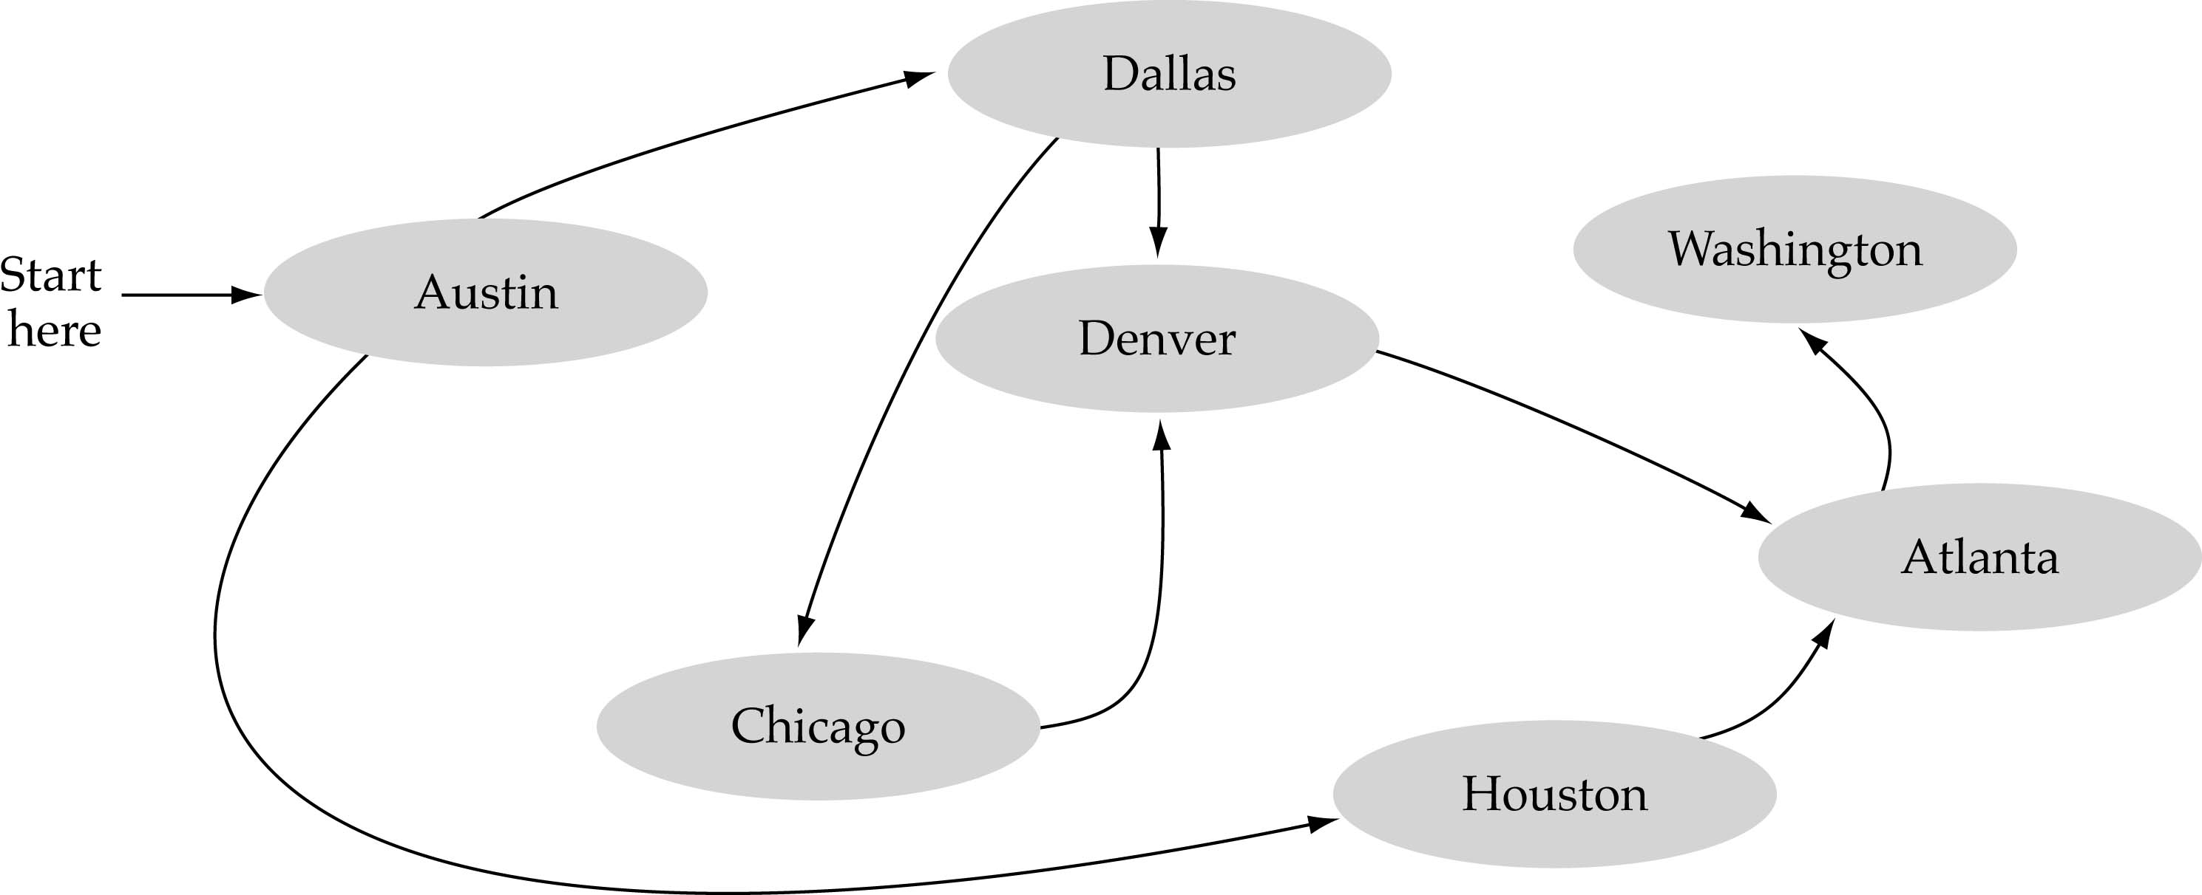
What is a graph?
A data structure that consists of a set of nodes (vertices) and a set of edges that relate the nodes to each other
The set of edges describes relationships among the vertices

Slide 4
Applications of graphs?
Social Media
Google maps
Computer networks
Transportations

Slide 5
Formal definition of graphs
A graph G is defined as follows:
G=(V,E)
V(G): a finite, nonempty set of vertices
E(G): a set of edges (pairs of vertices)

Slide 6
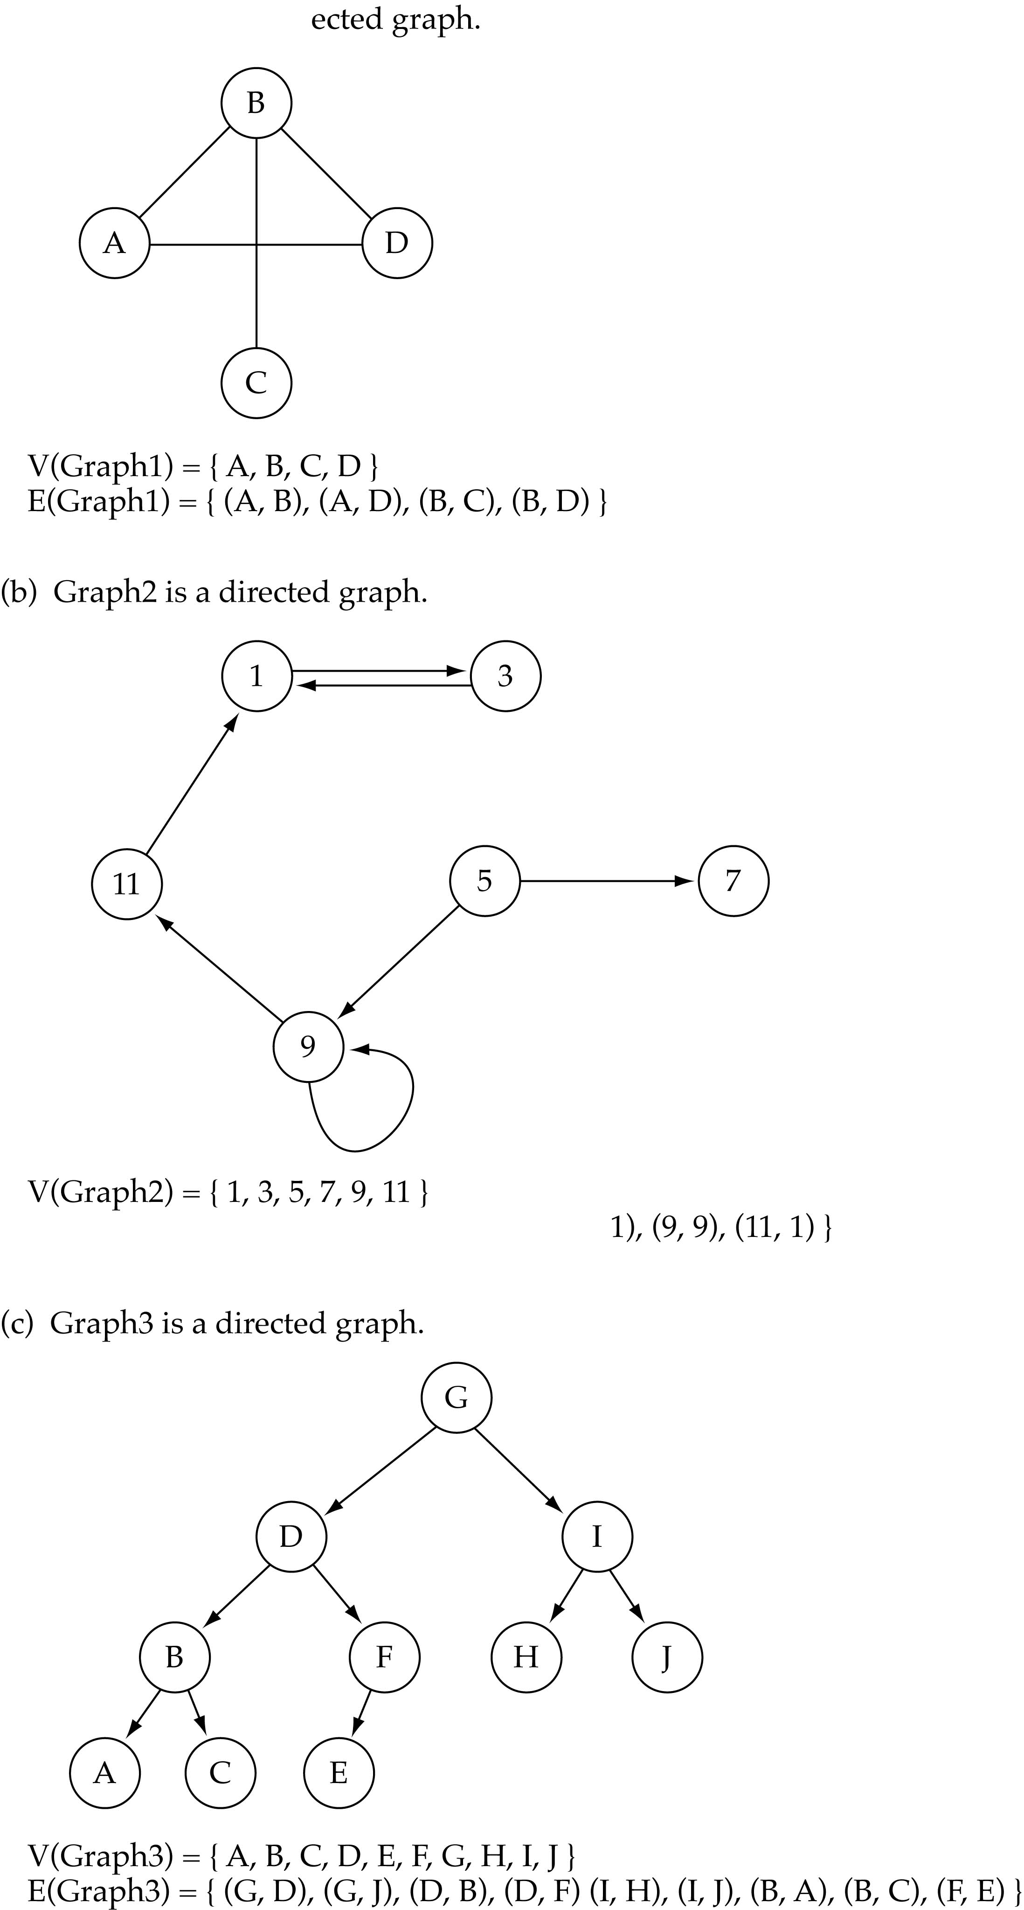
Directed vs. undirected graphs
When the edges in a graph have no direction, the graph is called undirected

Slide 7
Directed vs. undirected graphs (cont.)
When the edges in a graph have a direction, the graph is called directed (or digraph)
Warning: if the graph is directed, the order of the vertices in each edge is important !!
E(Graph2) = {(1,3) (3,1) (5,9) (9,11) (5,7)

Slide 8
Trees vs graphs
Trees are special cases of graphs!!

Slide 9
Graph terminology
Adjacent nodes: two nodes are adjacent if they are connected by an edge
Path: a sequence of vertices that connect two nodes in a graph
Complete graph: a graph in which every vertex is directly connected to every other vertex

Slide 10
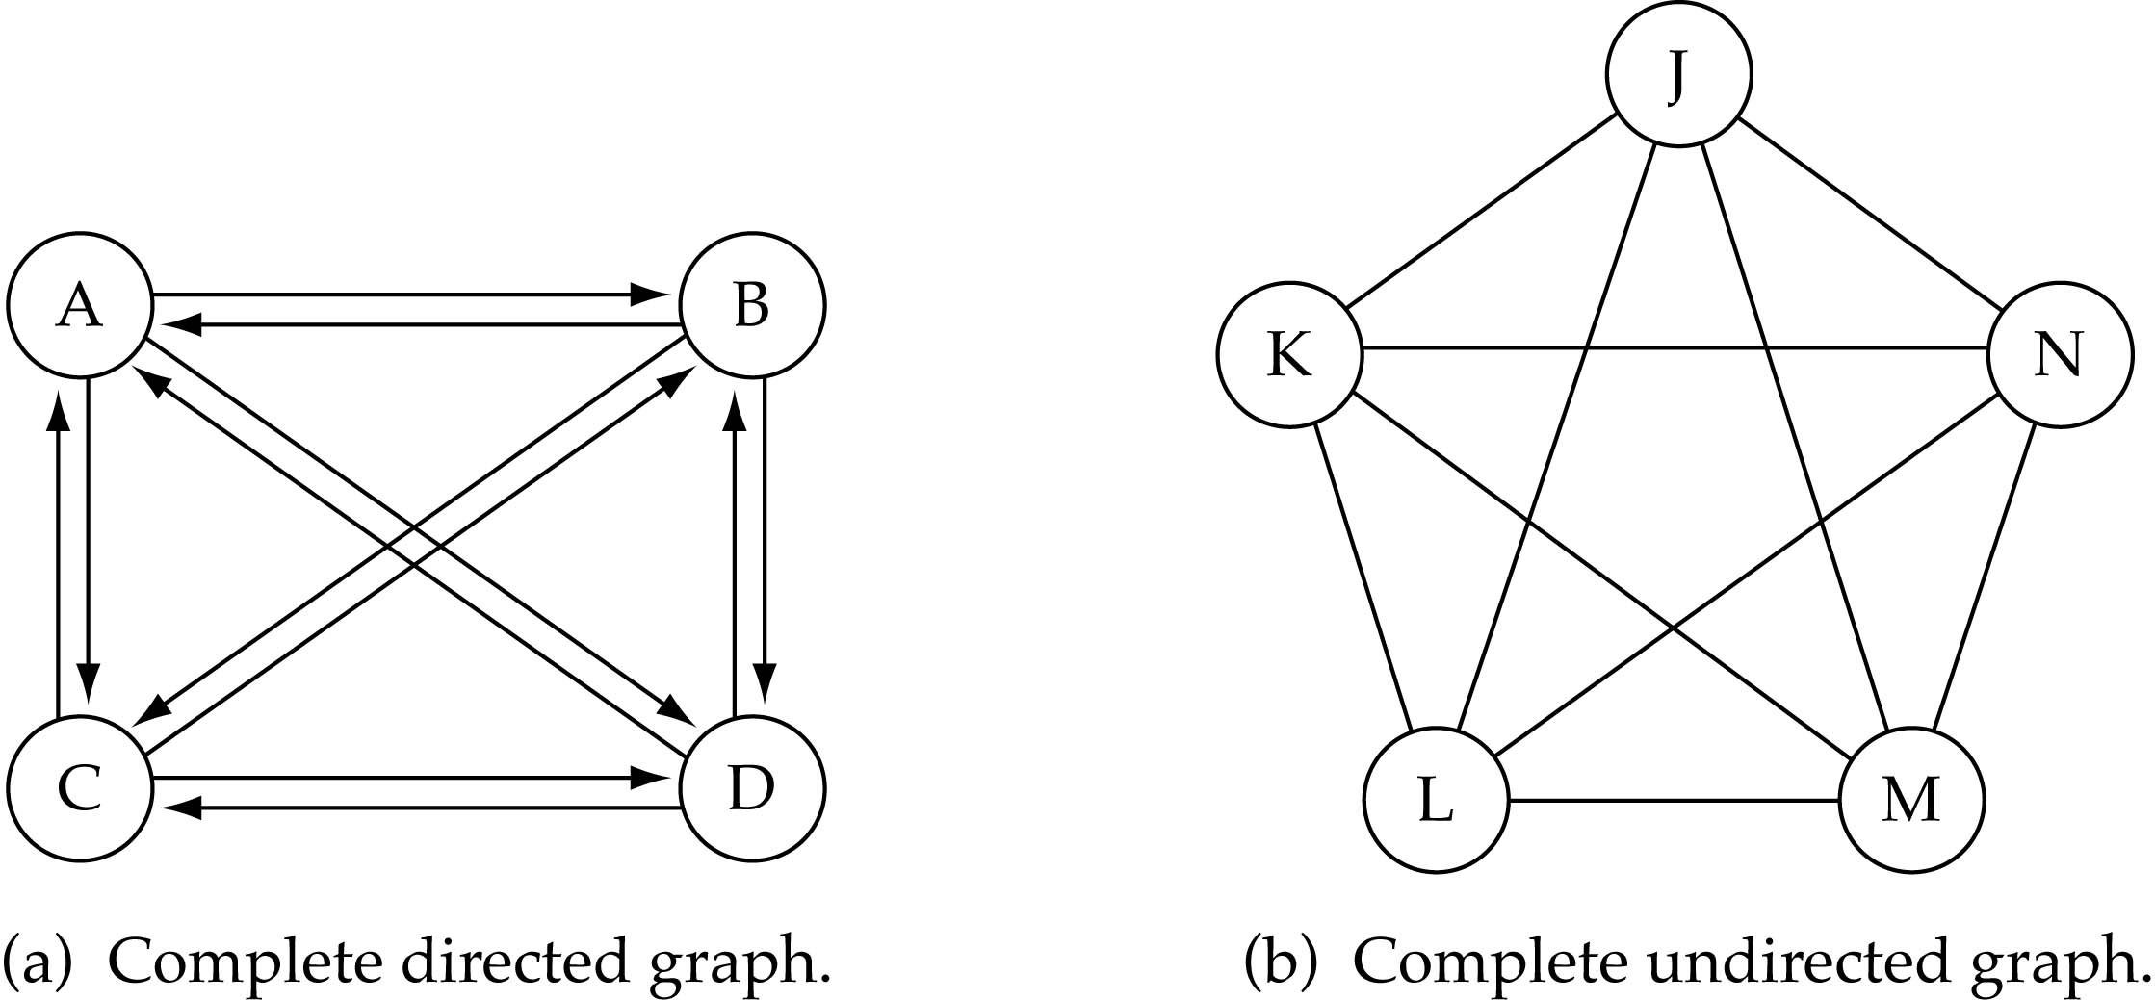
Graph terminology (cont.)
What is the number of edges in a complete directed graph with N vertices?
N * (N-1)

Slide 11
Graph terminology (cont.)
What is the number of edges in a complete undirected graph with N vertices?
N * (N-1) / 2

Slide 12
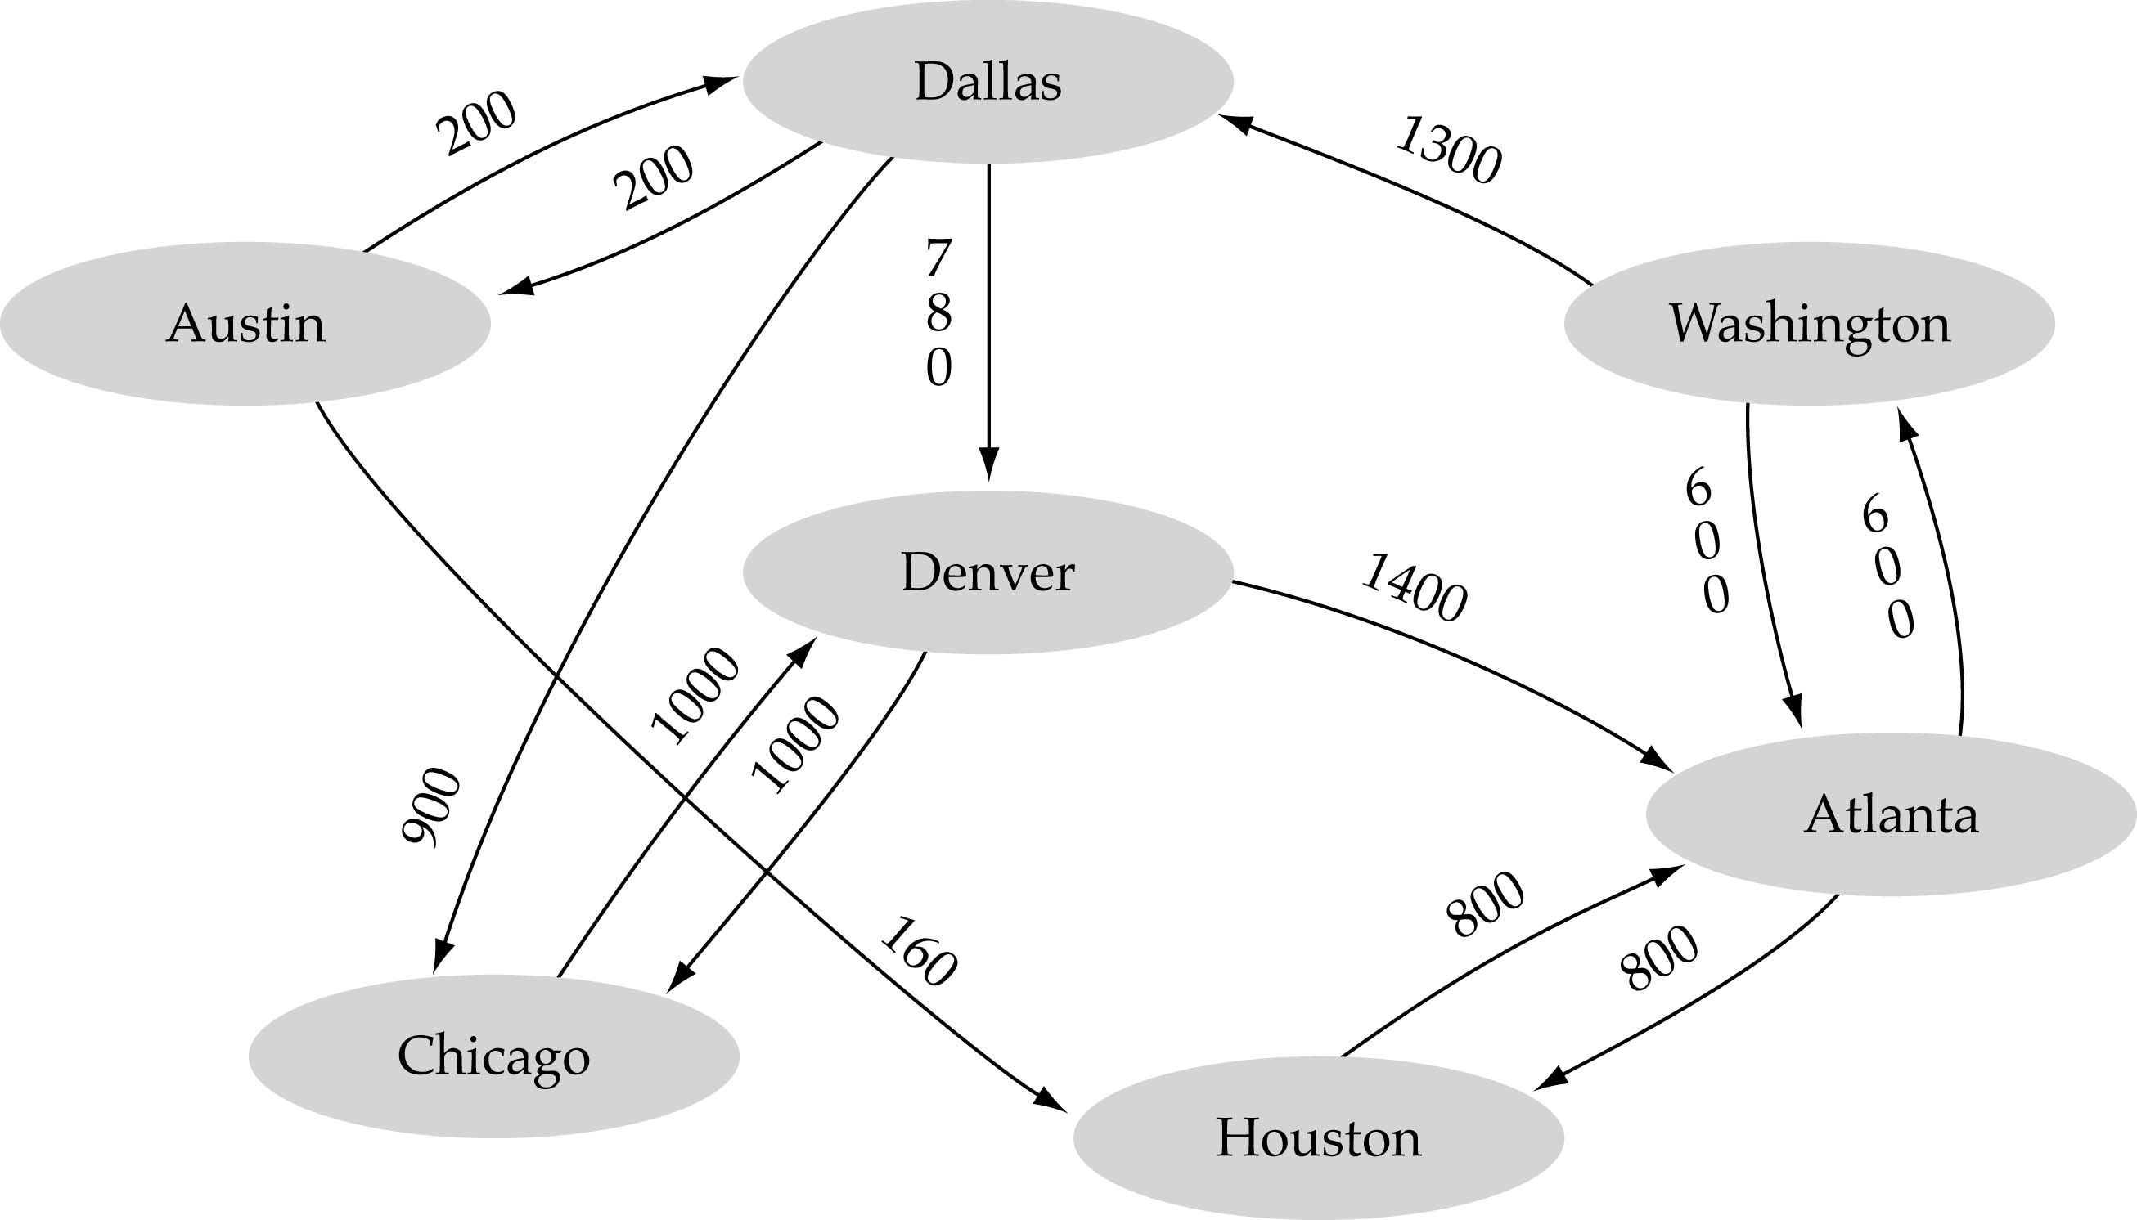
Graph terminology (cont.)
Weighted graph: a graph in which each edge carries a value

Slide 13
Graph implementation
Array-based implementation
A 1D array is used to represent the vertices
A 2D array (adjacency matrix) is used to represent the edges

Slide 14
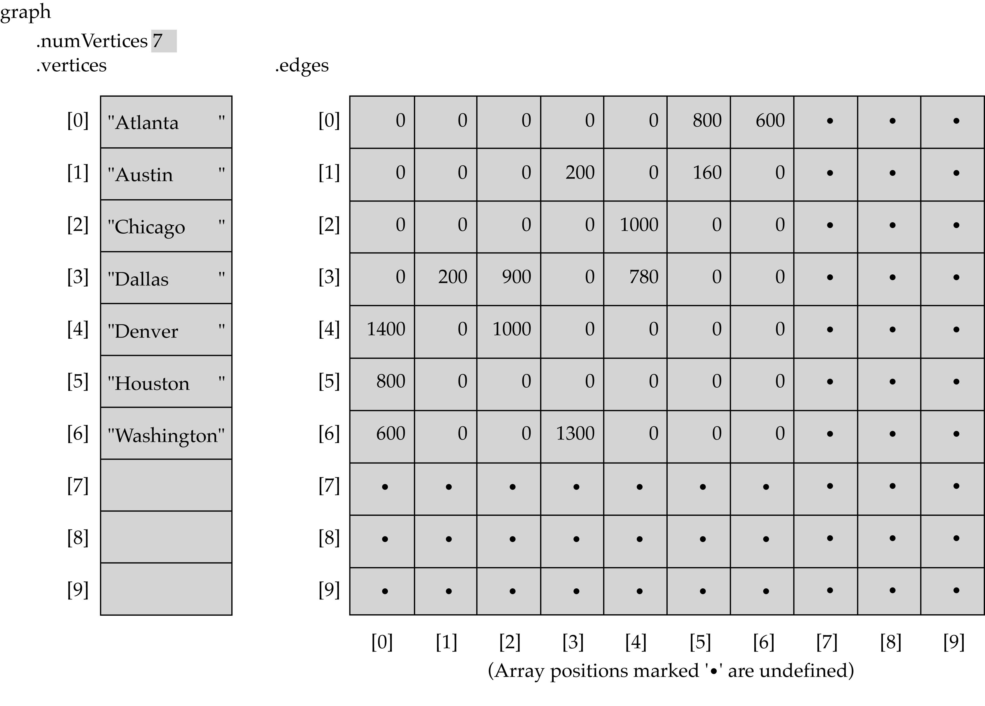
Array-based implementation

Slide 15
Graph implementation (cont.)
Linked-list implementation
A 1D array is used to represent the vertices
A list is used for each vertex v which contains the vertices which are adjacent from v (adjacency list)

Slide 16
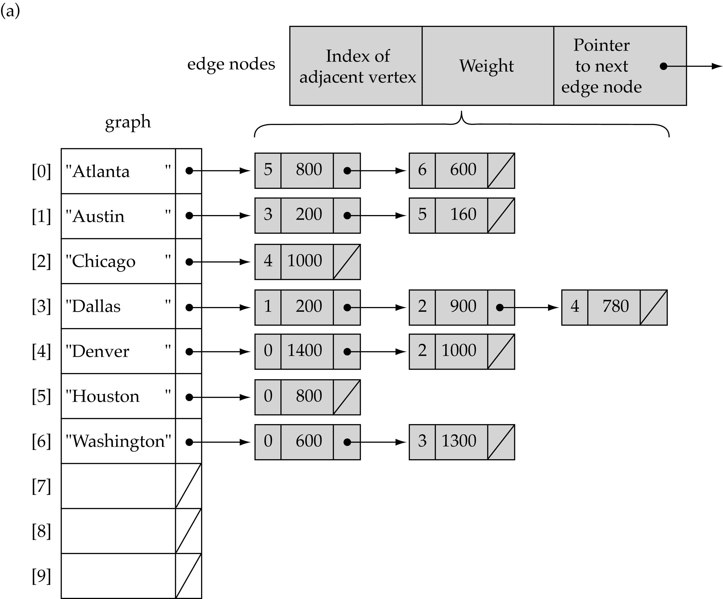
Linked-list implementation

Slide 17
Adjacency matrix vs. adjacency list representation
Adjacency matrix
Good for dense graphs --|E|~O(|V|²)
Memory requirements: O(|V| + |E| ) = O(|V|² )
Connectivity between two vertices can be tested quickly
Adjacency list
Good for sparse graphs -- |E|~O(|V|)
Memory requirements: O(|V| + |E|)=O(|V|)
Vertices adjacent to another vertex can be found quickly

Slide 18
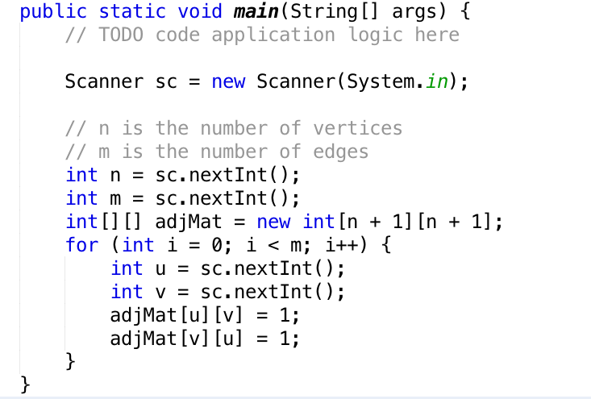
Adjacency matrix Implementation

Slide 19
Excercise
Write a method that take the graph as input (2d Array) and print the adacency matrix as a matrix.
Write a method that take the graph as input (2d Array) and print the graph as adacent vertices. You need to print each node in a line with adjacent nodes.

